Slide 1
Hotel booking analysis
Presented By:
SARTHAK NIGAM
SRM Institute of Science & Technology
Department- CSE

Slide 2
OUTLINE
Problem Statement
Proposed System/Solution
System Development Approach
Algorithm & Deployment
Result
Conclusion
Future Scope
References

Slide 3
Problem Statement
Have you ever wondered when the best time of year to book a hotel room is? Or the optimal length of stay in order to get the best daily rate? What if you wanted to predict whether or not a hotel was likely to receive a disproportionately high number of special requests? This hotel booking dataset can help you explore those questions! This data set contains booking information for a city hotel and a resort hotel, and includes information such as when the booking was made, length of stay, the number of adults, children, and/or babies, and the number of available parking spaces, among other things. All personally identifying information has been removed from the data. Explore and analyse the data to discover important factors that govern the bookings.

Slide 4
Proposed Solution
To effectively analyse hotel booking data and derive actionable insights, the following steps and components are proposed:
Data Collection and Integration:
Data Sources: Collect data from various sources such as booking systems, customer reviews, competitor pricing, and economic indicators.
Data Warehouse: Set up a data warehouse to store and manage the collected data, ensuring secure and efficient access.
Data Cleaning and Preprocessing:
Handling Missing Values: Identify and handle missing values through imputation or removal.
Data Consistency: Ensure data types are correct and consistent across the dataset.
Duplicate Removal: Detect and remove duplicate entries to maintain data integrity.
Exploratory Data Analysis (EDA):
Descriptive Statistics: Compute basic statistics to understand the distribution of key variables (e.g., booking lead times, stay durations, cancellation rates).
Visualization: Use visualization tools such as histograms, bar charts, and heatmaps to identify patterns and relationships within the data.
Predictive Modelling:
Cancellation Prediction: Develop machine learning models (e.g., logistic regression, decision trees, random forests) to predict the likelihood of booking cancellations based on booking attributes.
Demand Forecasting: Build time series models (e.g., ARIMA, Prophet) to forecast future booking demand and identify seasonal trends.
Customer Segmentation:
Clustering Algorithms: Apply clustering techniques (e.g., k-means, hierarchical clustering) to segment customers based on booking behaviour, demographics, and preferences.
Segment Analysis: Analyse each customer segment to tailor marketing strategies and personalize customer experiences.

Slide 5
Proposed Solution
Real-Time Data Processing:
Streaming Data: Implement real-time data processing pipelines using tools like Apache Kafka and Spark Streaming for continuous data ingestion and processing.
Dynamic Dashboards: Create interactive dashboards using tools like Tableau or Power BI for real-time monitoring and visualization of key performance indicators.
Sentiment Analysis:
Text Mining: Utilize natural language processing (NLP) techniques to analyse sentiment from customer reviews and feedback, identifying common themes and areas for improvement.
Personalization and Recommendations:
Recommendation Engine: Develop algorithms to provide personalized recommendations for additional services (e.g., room upgrades, spa treatments) based on customer profiles and booking history.
Targeted Marketing: Implement personalized marketing campaigns based on customer segments and predictive insights.
Operational Optimization:
Dynamic Pricing: Implement dynamic pricing strategies that adjust room rates based on demand forecasts, booking lead times, and competitive pricing.
Cancellation Policies: Review and adjust cancellation policies to reduce the impact of high-cancellation channels and enhance revenue stability.
Sustainability Initiatives:
Green Practices: Incorporate customer preferences for eco-friendly practices into operational strategies, promoting sustainable tourism and attracting environmentally conscious travellers.
Cross-Departmental Collaboration:
Staff Training: Use data-driven insights to inform staff training programs, improving service quality and customer satisfaction.
Operational Coordination: Ensure seamless collaboration between departments (e.g., housekeeping, front desk) to align operations with customer needs and preferences.
By following these steps, the hotel can leverage data-driven insights to optimize operations, enhance customer satisfaction, and achieve a competitive edge in the market. This comprehensive approach ensures that all aspects of the hotel booking process are analysed and improved, leading to better decision-making and increased profitability.

Slide 6
System Approach / steps followed:
Importing necessary packages and libraries.
Mount the file in Jupyter notebook and read the .xlsx file.
Analysing the data sheet.
Removing null / NAN / duplicate rows.
Fixing the outliers.
Drop certain columns / combined certain columns to make our data sheet free Avoid of any irrelevant data.
Applying the concept of Data Wrangling and Data Visualization such that we can analyse the data sheet and retrieve required information.

Slide 7
Algorithm & Deployment
Algorithms
Data Preprocessing:
Missing Value Imputation
Normalization/Standardization
Exploratory Data Analysis (EDA):
Descriptive Statistics
Data Visualization (Matplotlib, Seaborn, Plotly)
Predictive Modelling:
Cancellation Prediction:
Logistic Regression
Decision Trees
Random Forest
Gradient Boosting Machines (GBM)
Demand Forecasting:
ARIMA (Autoregressive Integrated Moving Average)
Prophet
LSTM (Long Short-Term Memory) Networks
Customer Segmentation:
K-Means Clustering
Hierarchical Clustering
DBSCAN (Density-Based Spatial Clustering of Applications with Noise)
Sentiment Analysis:
Text Mining (NLTK, SpaCy)
Sentiment Analysis Models (VADER, TextBlob)
Advanced NLP Techniques (BERT)
Recommendation Systems:
Collaborative Filtering (Matrix Factorization, SVD)
Content-Based Filtering
Hybrid Models

Slide 8
Algorithm & Deployment
Deployment Details
Infrastructure Setup:
Cloud Platform (AWS, Azure, Google Cloud)
Data Warehouse (Amazon Redshift, Google BigQuery)
Model Training and Evaluation:
Environment (Jupyter notebooks, IDEs like PyCharm)
Version Control (Git)
Real-Time Data Processing:
Streaming Data Pipeline (Apache Kafka)
Data Processing Framework (Apache Spark, Flink)
Model Deployment:
Model Serving (AWS SageMaker, Azure ML, Google AI Platform)
API Endpoints (Flask, FastAPI)
Dashboard and Visualization:
Interactive Dashboards (Tableau, Power BI)
Custom Web Applications (Dash, Streamlit)
Monitoring and Maintenance:
Logging and Monitoring (ELK Stack, Prometheus, Grafana)
Model Retraining Pipelines
Feedback Loop for Continuous Improvement

Slide 9
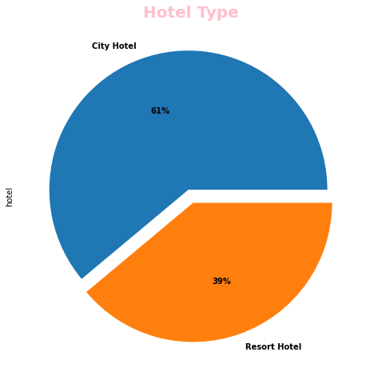
Analysis & Observations
Hotel Type Percentage
We observed City Hotel shares 61% out of 100 than Resort Hotel.

Slide 10
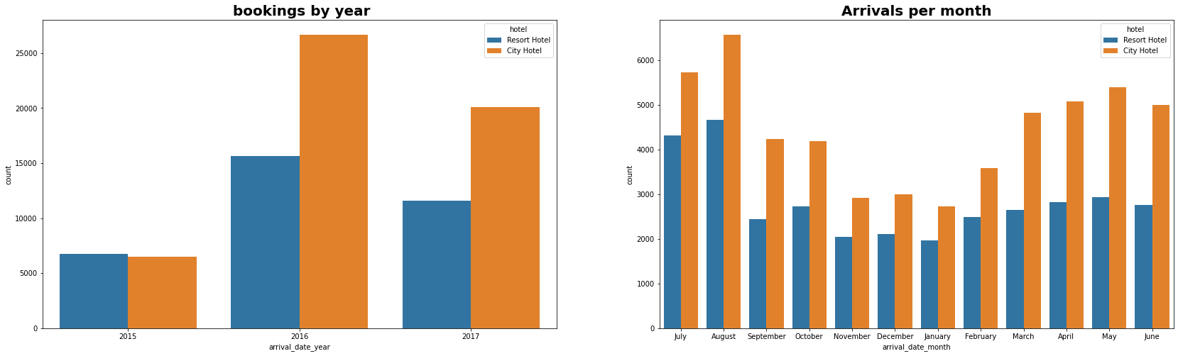
Analysis & Observations
2) Hotel Wise Bookings based on Month and Year
Bookings for City hotels are higher than Resort hotels over the years and in year 2016 the bookings for both the hotels were maximum.
Most bookings were done in the month of May, June, July, August.

Slide 11
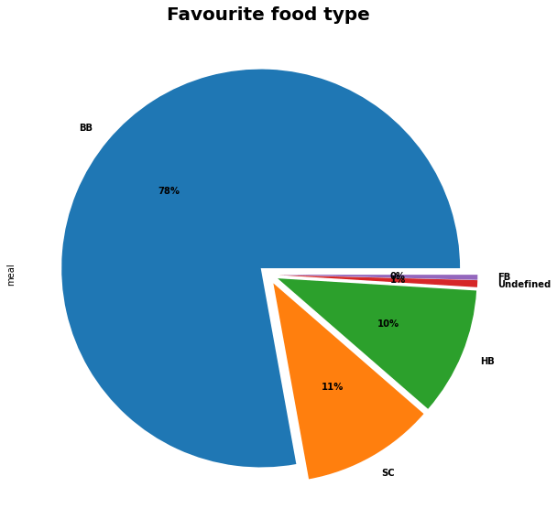
Analysis & Observations
3) Favorite meal by hotel type
BB-Bed and Breakfast
HB-Half Board
FB-Full Board
SC-Self Catering
We observed 78% of people prefer 'BB' type meal.

Slide 12
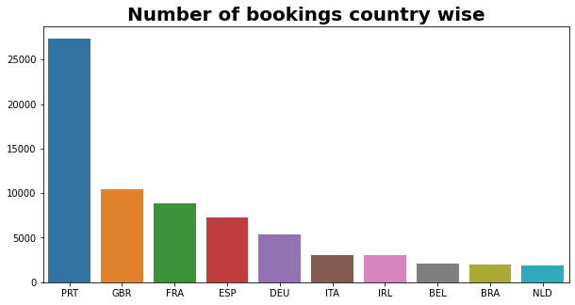
Analysis & Observations
4) From which country guests are visiting the hotel?
We observed most guests visited the hotels where from European countries and most of them from Portugal.

Slide 13
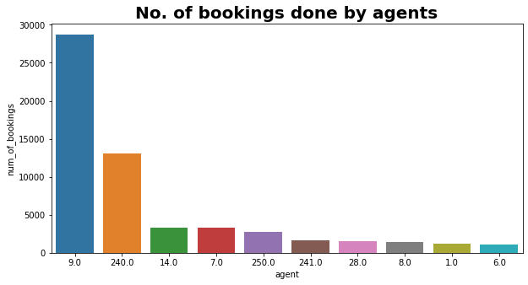
Analysis & Observations
5) Which agent made the maximum bookings?
We observed Agent no. 9 has made most no. of bookings.

Slide 14
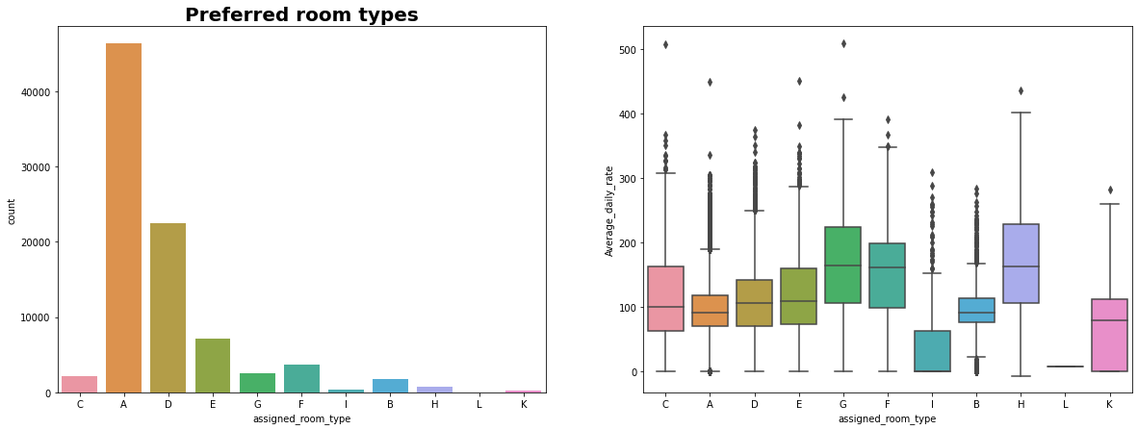
Analysis & Observations
6) Preferred Room Type
It's clearly seen that the most people preferred Type A, type of room. Also, the average daily rate of type A rooms seems to be less .
Also, those whose average daily rate is higher i.e.(Type C,G,F,H) it's seen that preference is also less.

Slide 15
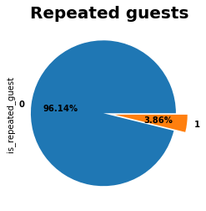
Analysis & Observations
7) Percentage of guests visiting the hotel repeatedly
We observed nearly 4% people are repeated guests.
The guests retention rate is low, which is a concern.

Slide 16
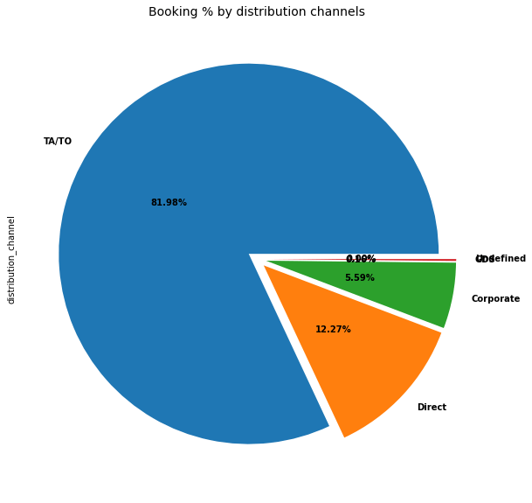
Analysis & Observations
8) Distribution Channel Type
We observed 81.98% of share is occupied by TA/TO
Where TA/TO stand for Travel Agent/Travel organisation.

Slide 17
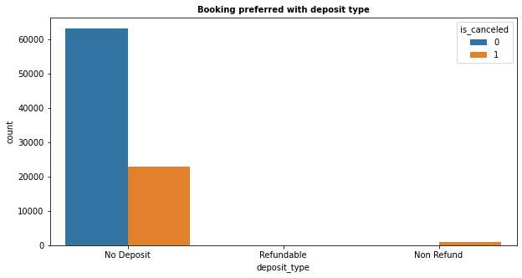
Analysis & Observations
9) Bookings preferred with deposit type
As expected , Most Bookings are done with 'No deposit' and most cancellations are also in 'no deposit' bookings. It is a surprise to see cancellations with 'Non-refundable' bookings

Slide 18
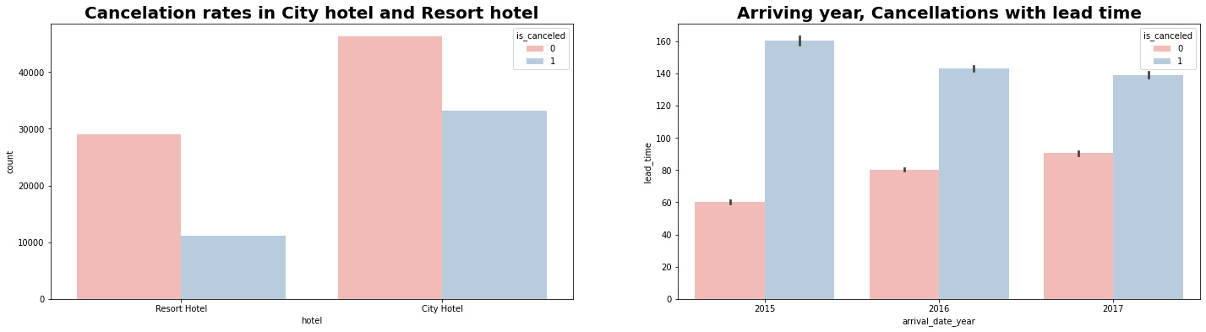
Analysis & Observations
10) Cancellation rates in hotel and year-wise analysis
We observed rate of cancellation is higher in City hotel.
In year 2015 rate of cancellation was low.

Slide 19
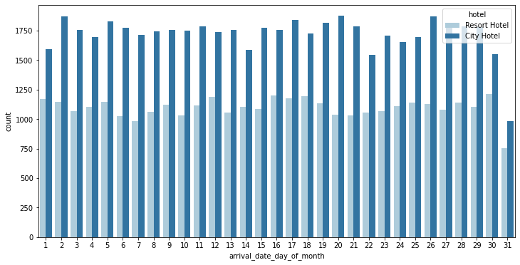
Analysis & Observations
11) Day-wise analysis of guests arrival
We observed everyday the guest arrival is more in city hotel .

Slide 20
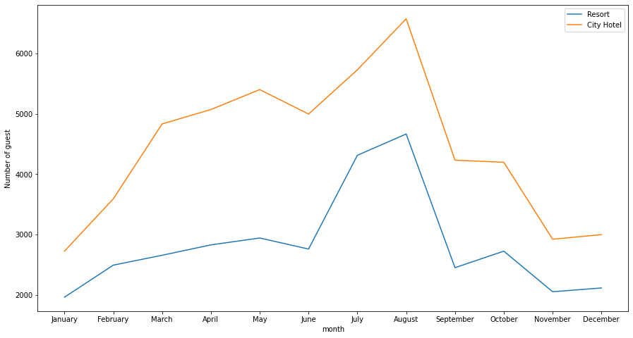
Analysis & Observations
12) Figuring out the busiest months of the year
We observed that the busiest months for both the hotels are May, June, July, August

Slide 21
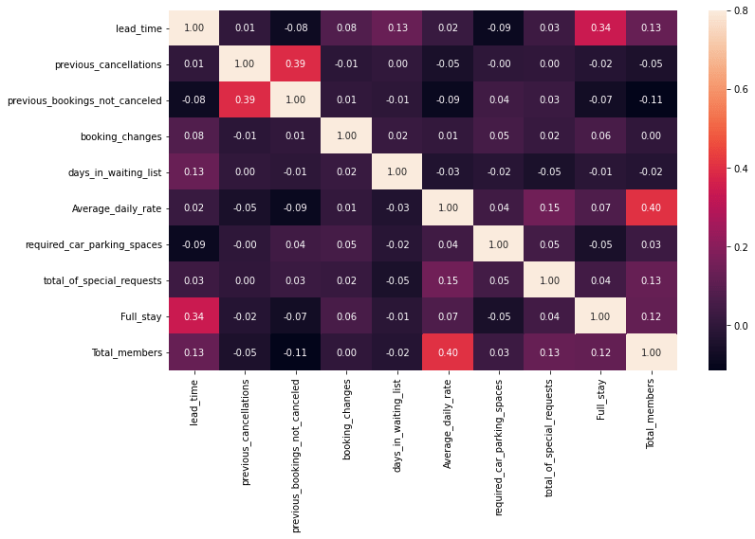
Analysis & Observations
13) Analysing the correlation
Full_stay length and lead time have slight correlation. This may means that for longer hotel stays people generally plan little before the the actual arrival.
Average_daily_rate is slightly correlated with Total_members, which makes sense as more no. of people means more revenue, therefore more Average_daily_rate.

Slide 22
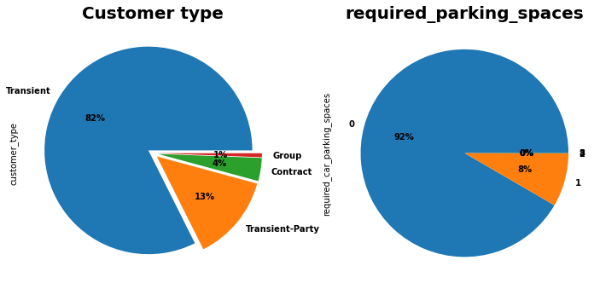
Analysis & Observations
14) Customer type and car parking details
There are 4 types of Customer. Out of them most are 'Transient Type"
only 8% people require parking spaces

Slide 23
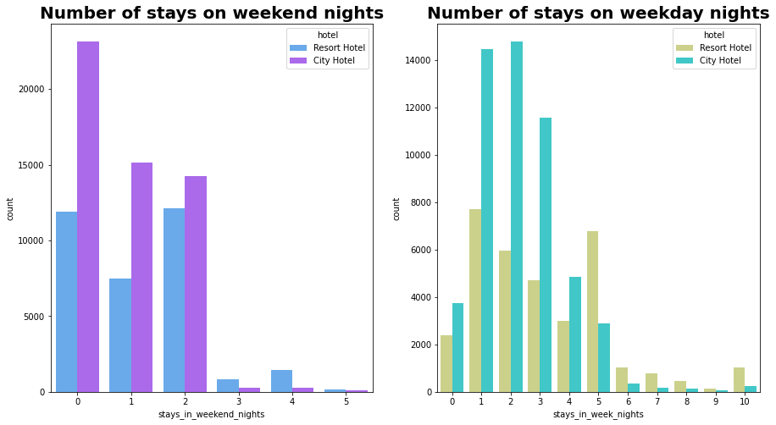
Analysis & Observations
15) Bookings on weekends and weekdays
We observed that City hotels have more number of stays irrespective of week or weekend stays.

Slide 24
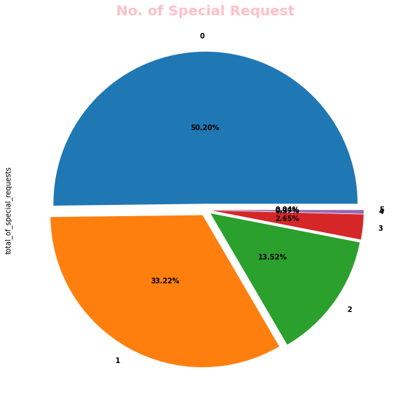
Analysis & Observations
16) Special requests service offered by hotels
We observed City hotels have more no. of special requests. Most of them ask for only 1 special request.

Slide 25
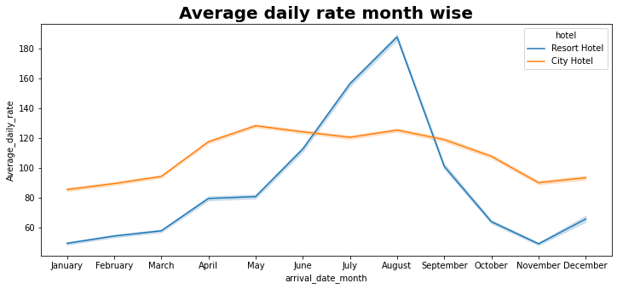
Analysis & Observations
17) Average_daily_rate month-wise
We observed: For resort hotels, the average daily rate is more expensive during August, July and September.
For city hotels, the average daily rate is more expensive during August, July, June and May.

Slide 26
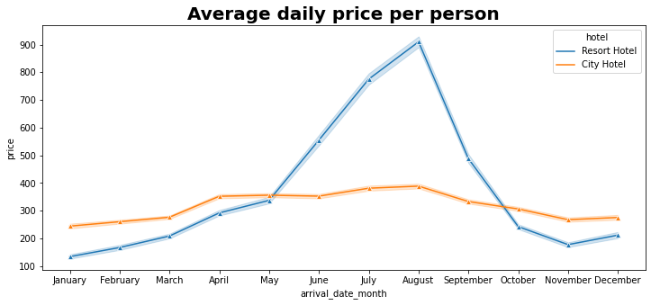
Analysis & Observations
18) Average_daily_price per person
Prices of resort hotel are much higher.
Prices of city hotel do not fluctuate that much.

Slide 27
Result
This project helped to solve some common questions related to the hotel booking scenario. With this project we can get various info like best time for holidays, length of stay, type of hotel, avg length of stay etc.
The hotel booking analysis provided valuable insights into customer behavior, booking patterns, and cancellation trends. By leveraging these insights, the hotel can make informed decisions to optimize operations, enhance customer satisfaction, and increase profitability. Future work can involve integrating more data sources, such as customer reviews and competitor pricing, to further refine the analysis and recommendations.

Slide 28
Conclusion
Around 61% bookings are for City hotel and 39% bookings are for Resort hotel, therefore City hotel is busier than Resort hotel.
The majority of guests come from western Europe countries. We should spend a significant amount of our budget on those area.
July- August are the busiest and profitable months for both of hotels.
Couples are the most common guests for hotels, hence hotels can plan services according to couples needs to increase revenue.
July and August month have high Average daily price per person for resort hotel.
Most common stay length is less than 4 days and generally people prefer City hotel for short stay, but for long stays, Resort Hotel is preferred.
November, December, February and January are the months which has less booking this period you can get rooms with less average daily rate.

Slide 29
Future scope
The future scope of this hotel booking analysis project includes incorporating external data sources such as customer reviews, competitor pricing, and economic indicators to gain deeper insights. Advanced predictive modelling using machine learning can improve accuracy in forecasting cancellations and demand. Real-time data analysis and dynamic dashboards will enable up-to-date monitoring and immediate strategy adjustments. Sentiment analysis of customer feedback can provide qualitative insights, while personalized marketing and recommendation systems can enhance customer engagement. Exploring new market segments, such as business travellers and event-based bookings, and integrating sustainability metrics can attract diverse customer bases. Comprehensive customer journey mapping and cross-departmental collaboration will optimize operations and improve the guest experience. These enhancements will transform the project into a dynamic system that adapts to market conditions and customer needs, driving sustained growth and competitive advantage for the hotel.

Slide 30
References
Dataset provided by Edunet Foundation

Slide 31
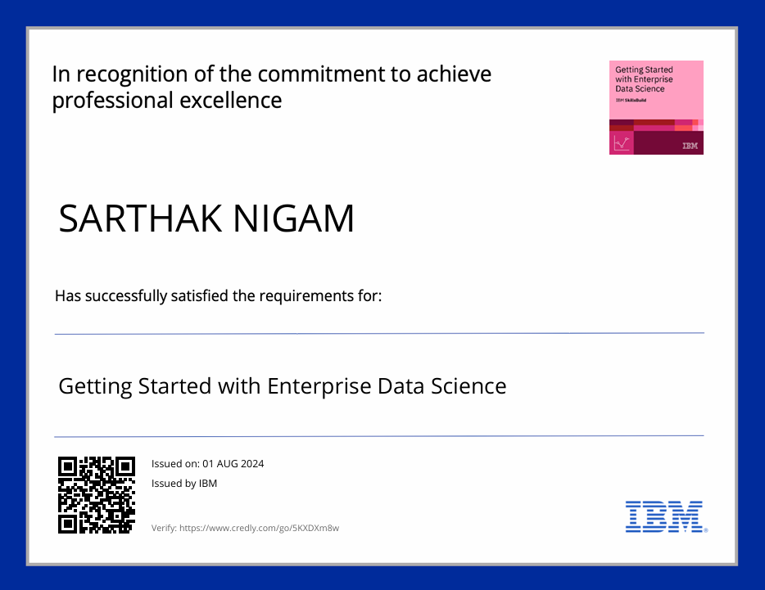
course certificate 1

Slide 32
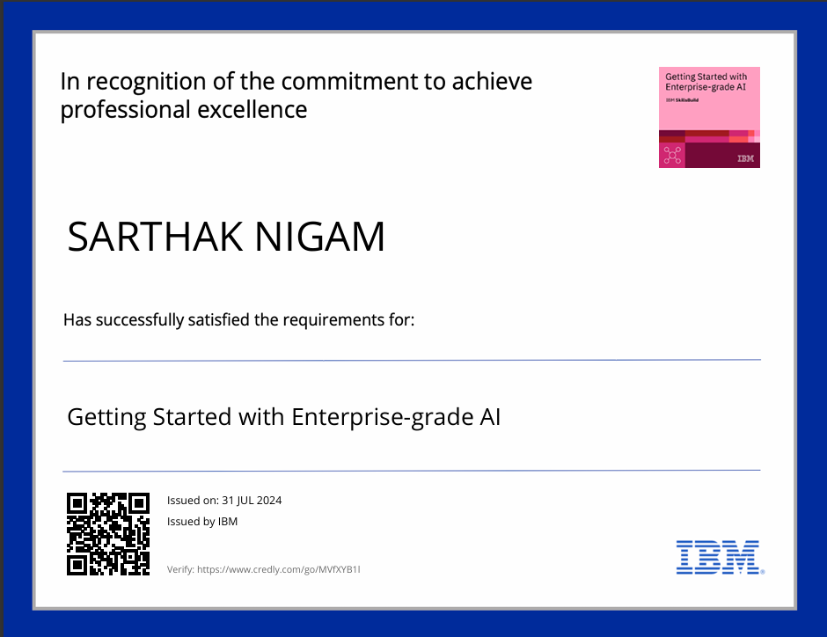
course certificate 2

Slide 33
THANK YOU

